Slide 1
Ensemble Learning
Jia-Wei, Liao
2021 / 8 / 28
Applied Mathematics, NYCU

Slide 2
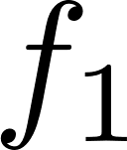
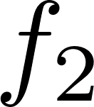
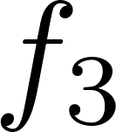

Ensemble

Slide 3
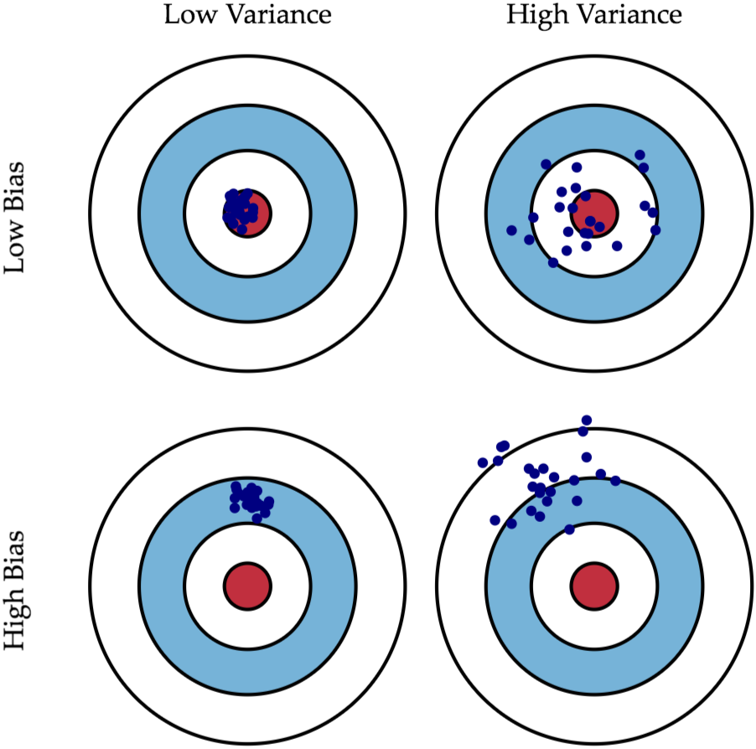
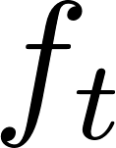
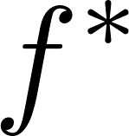
Variance and Bias

Slide 4
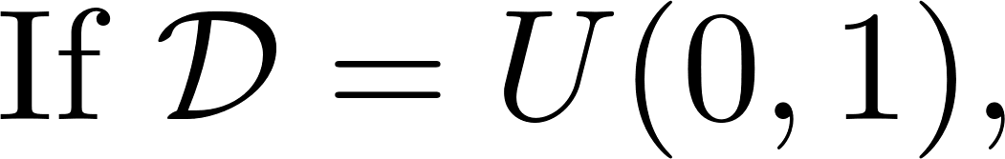
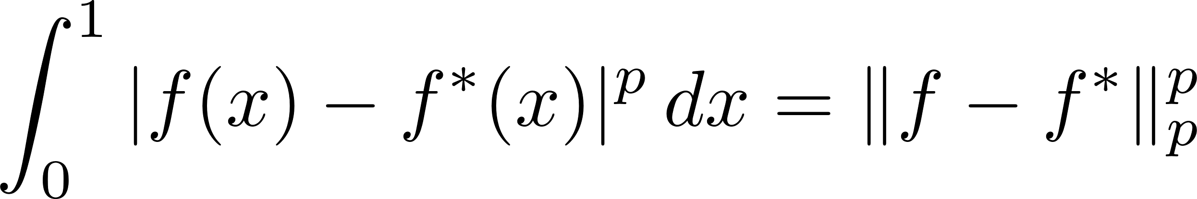
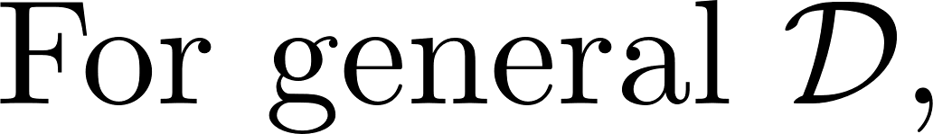
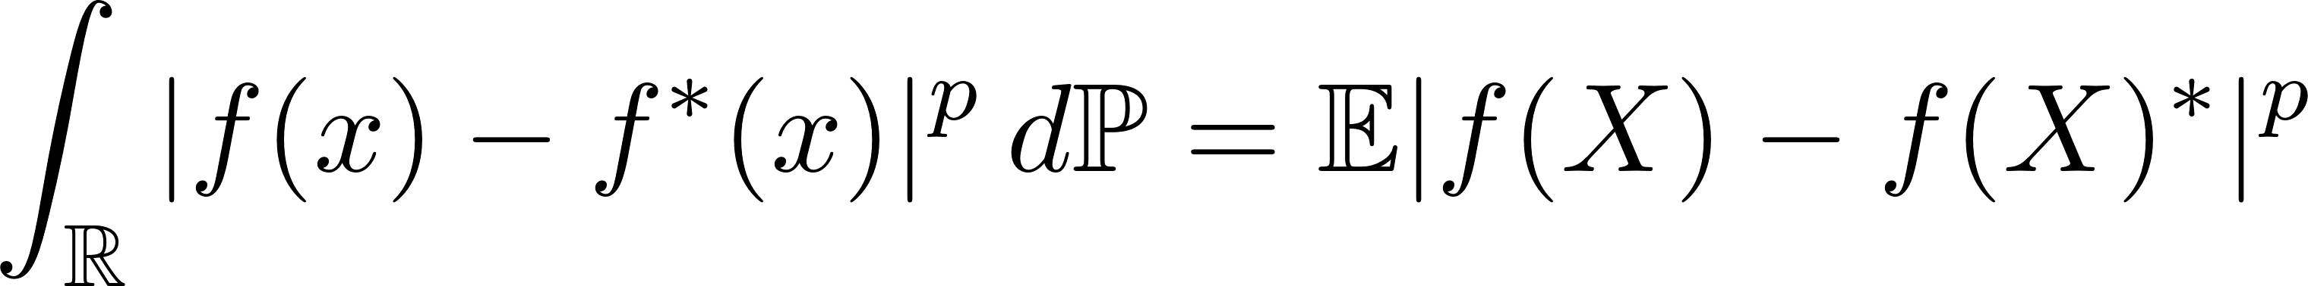
Bias

Slide 5

Blending / Voting
Training set 1
Model 1
Training set 1
Model 2
Training
$$⋮$$
Training set n
Model n

Slide 6
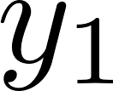
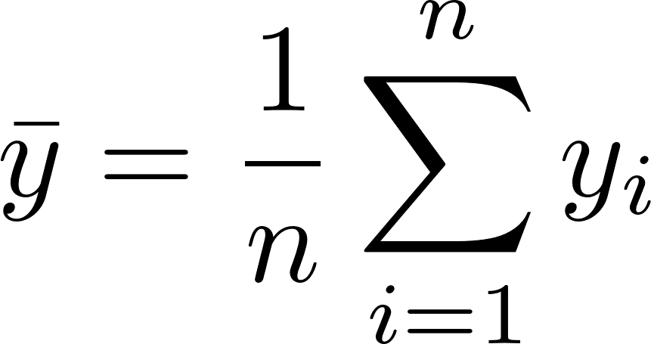
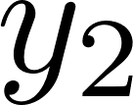
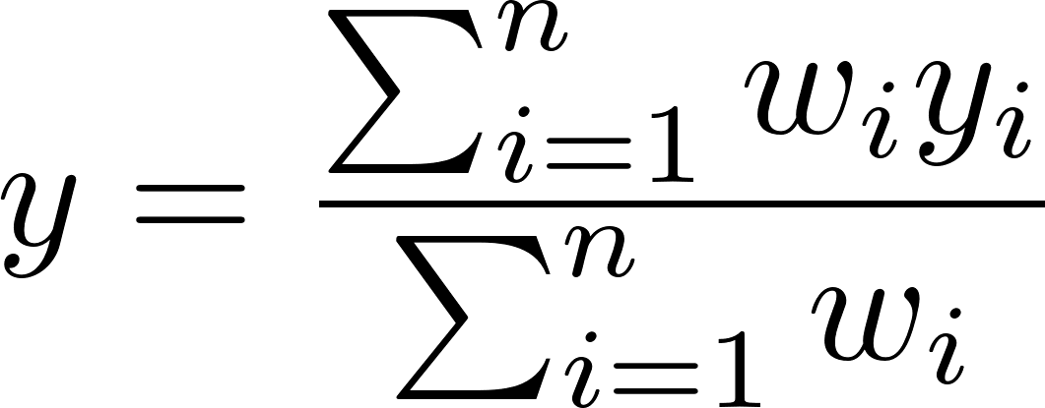
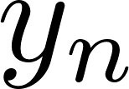

Blending / Voting
Model 1
Voting / Average
Model 2
Uniform:
Test data
$$⋮$$
Predicted
Weighted:
Model n

Slide 7
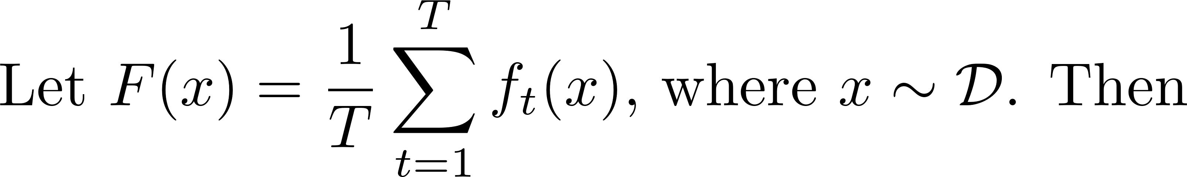
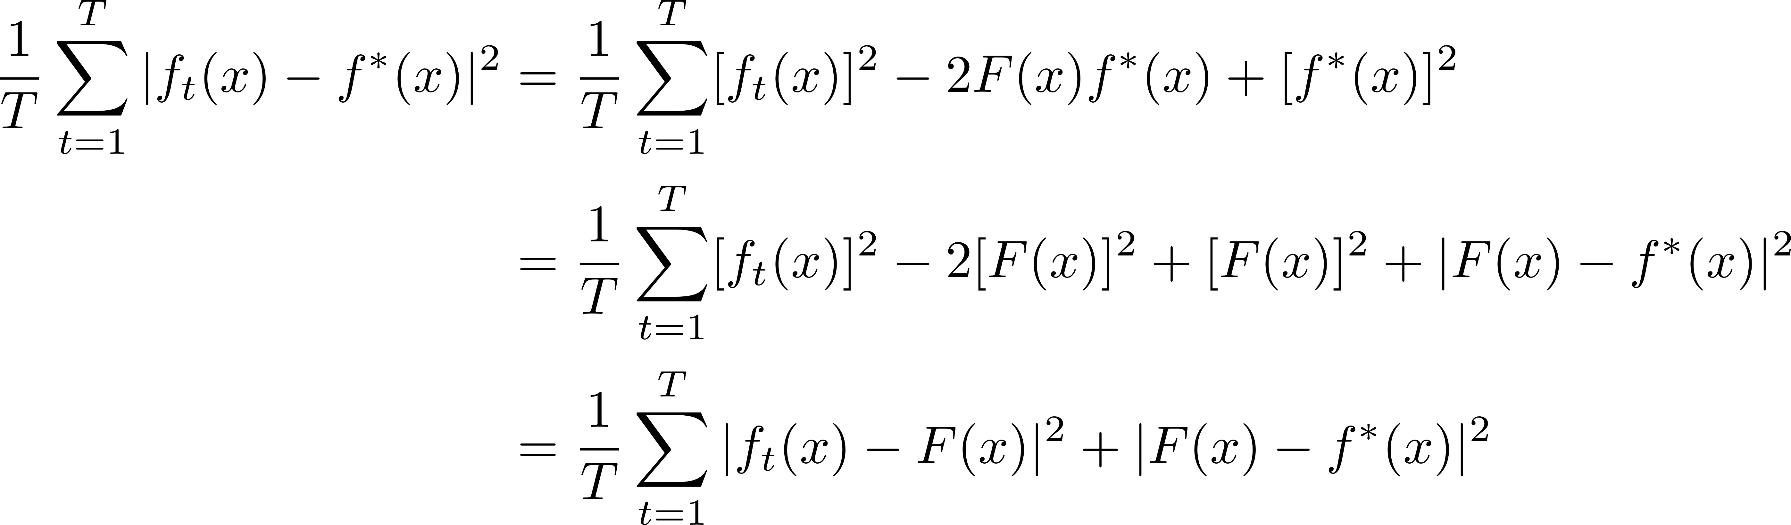
Uniform Blending

Slide 8
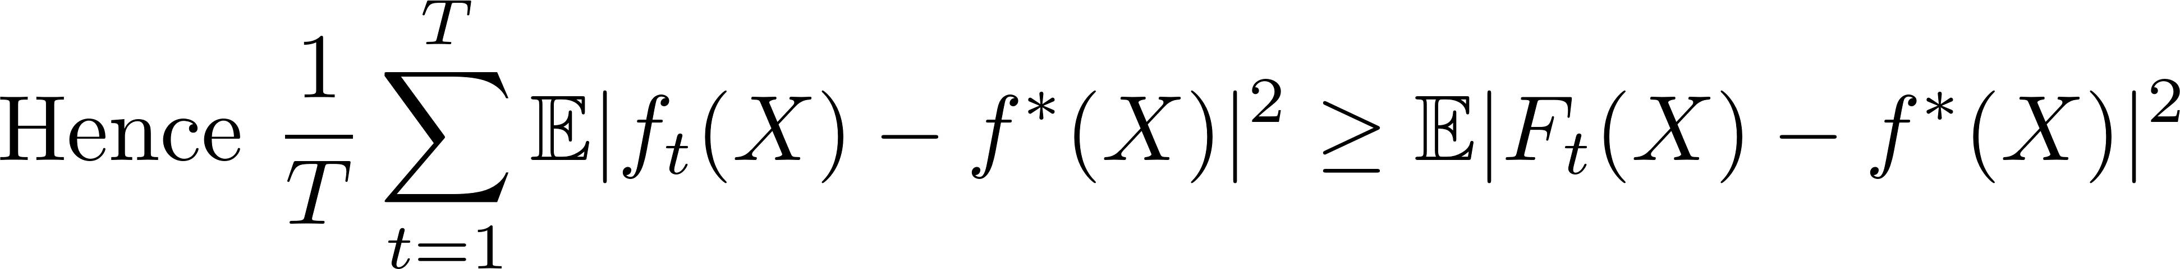
Uniform Blending
Mean of bias
Bias of Ft

Slide 9
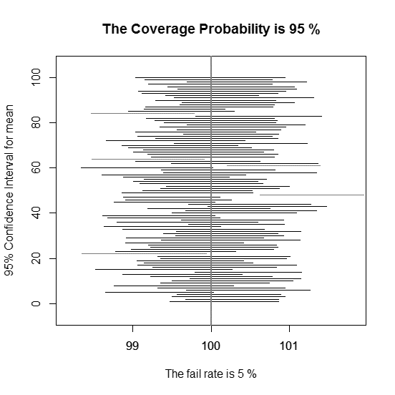
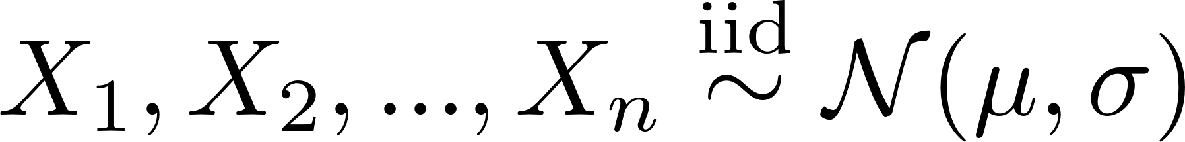
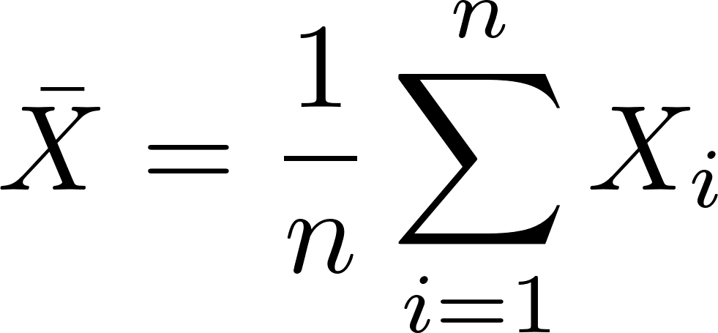
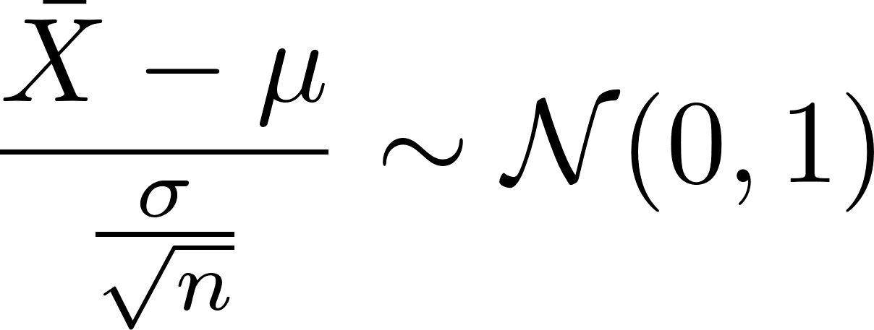
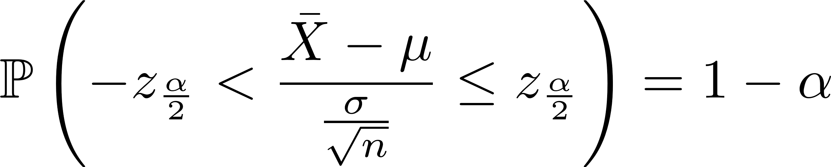
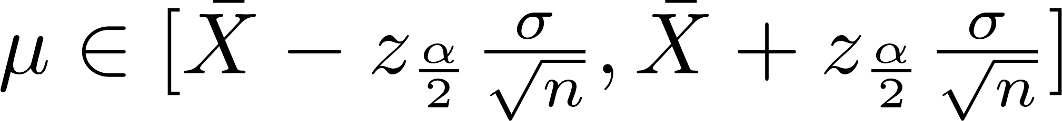
Interval Estimation

Slide 10
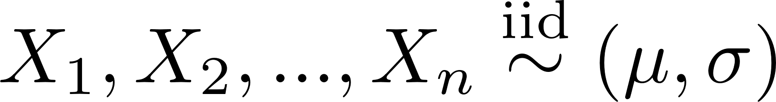
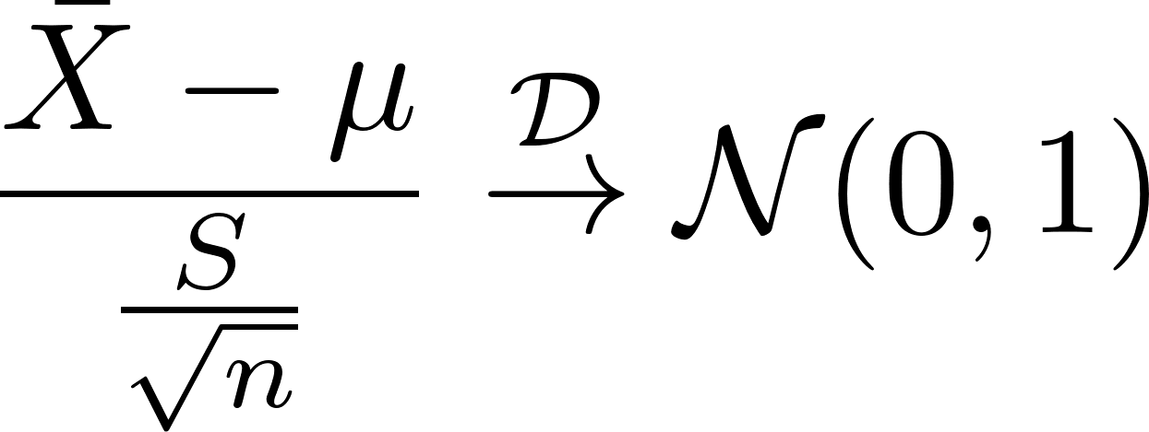

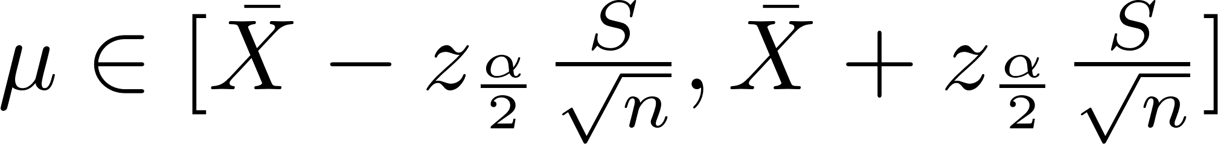
Interval Estimation

Slide 11
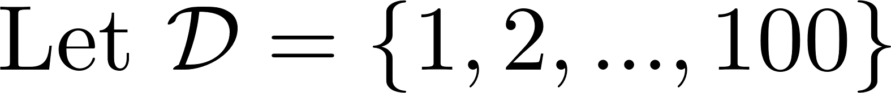
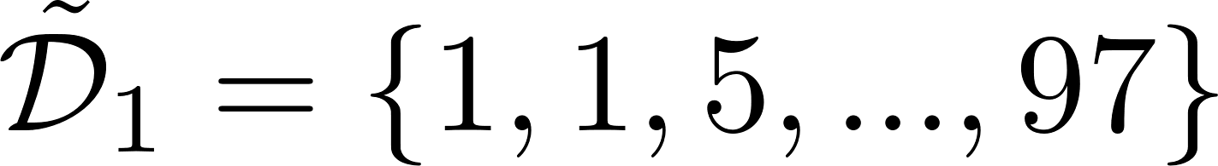
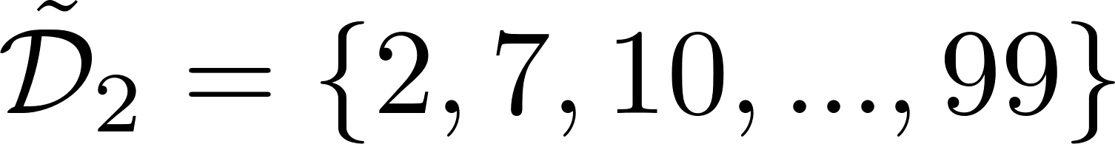
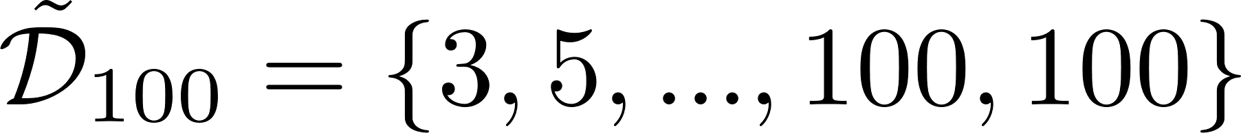
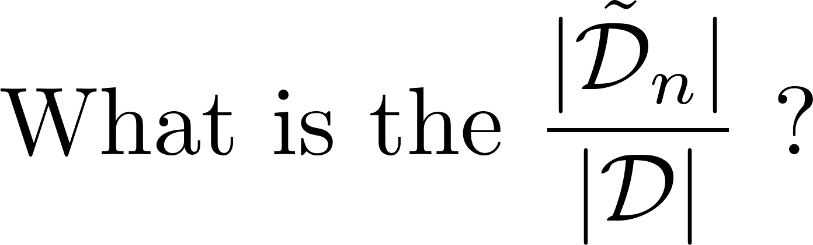
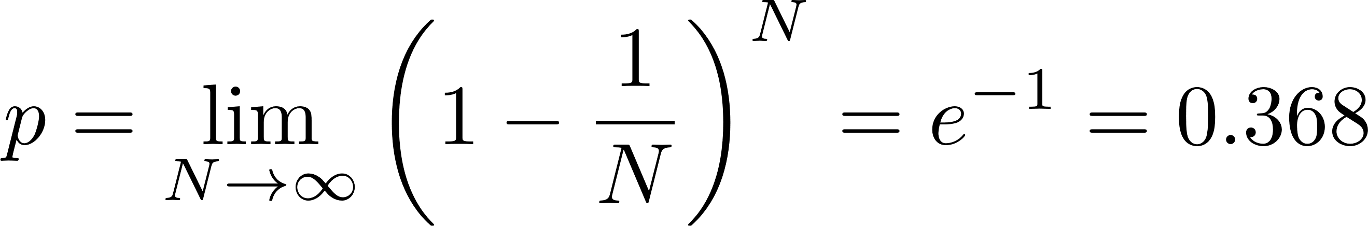
Bootstrapping

Slide 12

Bootstrap Aggregation (Bagging)
Model 1
Sample n data
Model 2
Dataset
(N data)
$$⋮$$
Model n

Slide 13
Bootstrap Aggregation (Bagging)
Model 1
Voting / Average
Model 2
Test data
Predicted
$$⋮$$
Model n

Slide 14
Blending / Voting
Model 1
Voting / Average
Model 2
Uniform:
Test data
$$⋮$$
Predicted
Weighted:
Model n

Slide 15

Stacking
Stage 1
Model 1
Stage 2
Model 2
Validation set
Model
$$⋮$$
Predicted
Final Predicted
Model n

Slide 16
Stacking with k-fold validation
Fold 1
Fold 2
Fold 3
Fold 4
Fold 5
Val 1
Train
Train
Train
Train
Model 1
Train
Val 2
Train
Train
Train
Model 2
Train
Train
Val 3
Train
Train
Model 3
Train
Train
Train
Val 4
Train
Model 4
Train
Train
Train
Train
Val 5
Model 5

Slide 17
Stacking with k-fold validation
Stage 1
Val 1
Model 1
Val 2
Model 2
Stage 2
Val 3
Model 3
Model
y
Val 4
Model 4
Val 5
Model 5

Slide 18
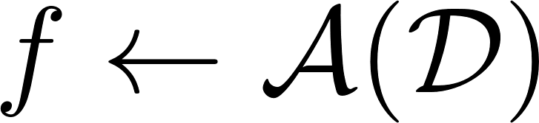
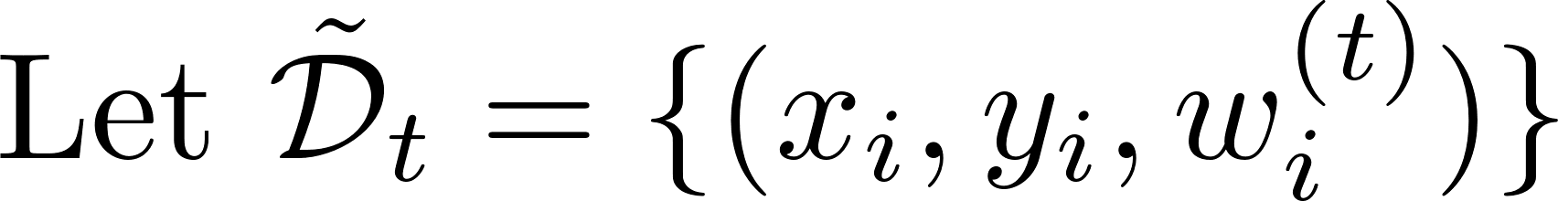
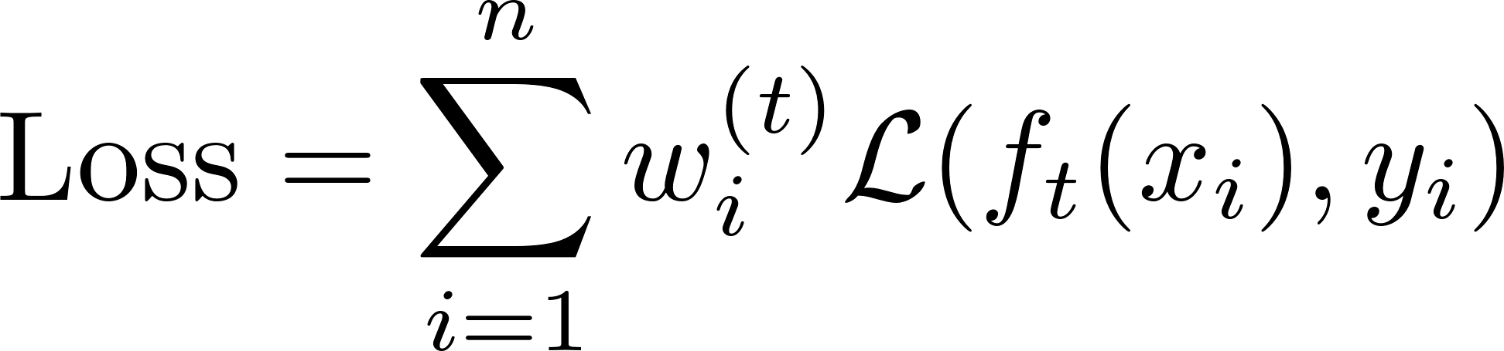
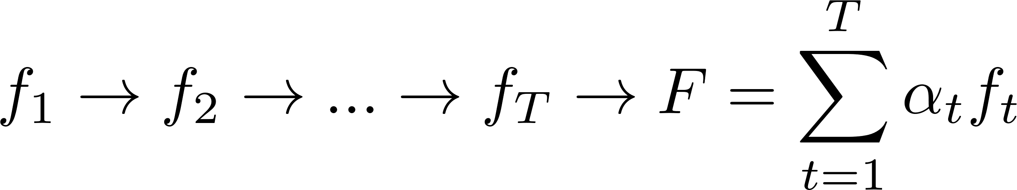
Adaptive Boosting (Adaboost)

Slide 19

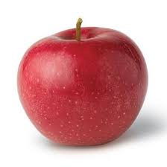

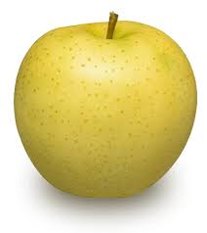
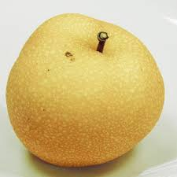
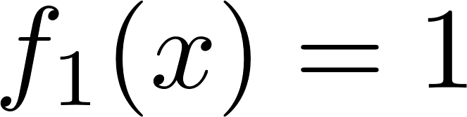
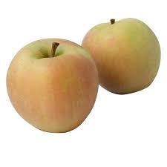
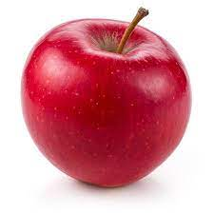
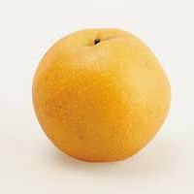
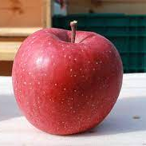
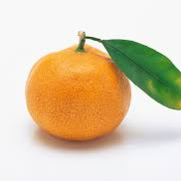
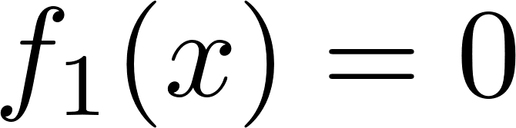
Adaboost round 1: get f1

Slide 20
Adaboost round 1: re-weighting

Slide 21
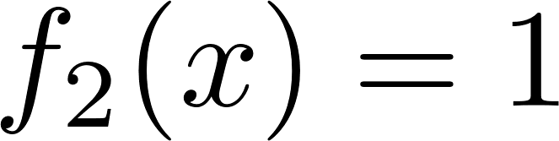
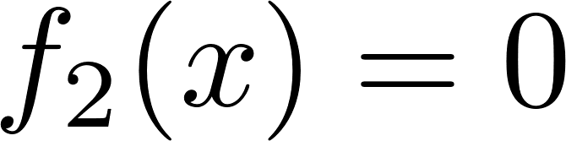
Adaboost round 2: get f2

Slide 22
Adaboost round 2: re-weighting

Slide 23
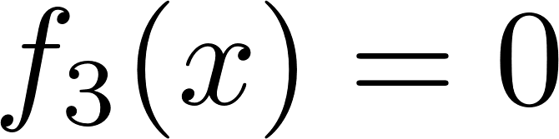

Adaboost round 3: get f3

Slide 24


Adaptive Boosting (Adaboost)
Error rate:
Incorrect:
Correct:

Slide 25





Adaptive Boosting (Adaboost)

Slide 26



Adaptive Boosting (Adaboost)

Slide 27









Adaboost algorithm

Slide 28


Convergence analysis

Slide 29




Convergence analysis

Slide 30
Thanks for listening!

